Slide 1
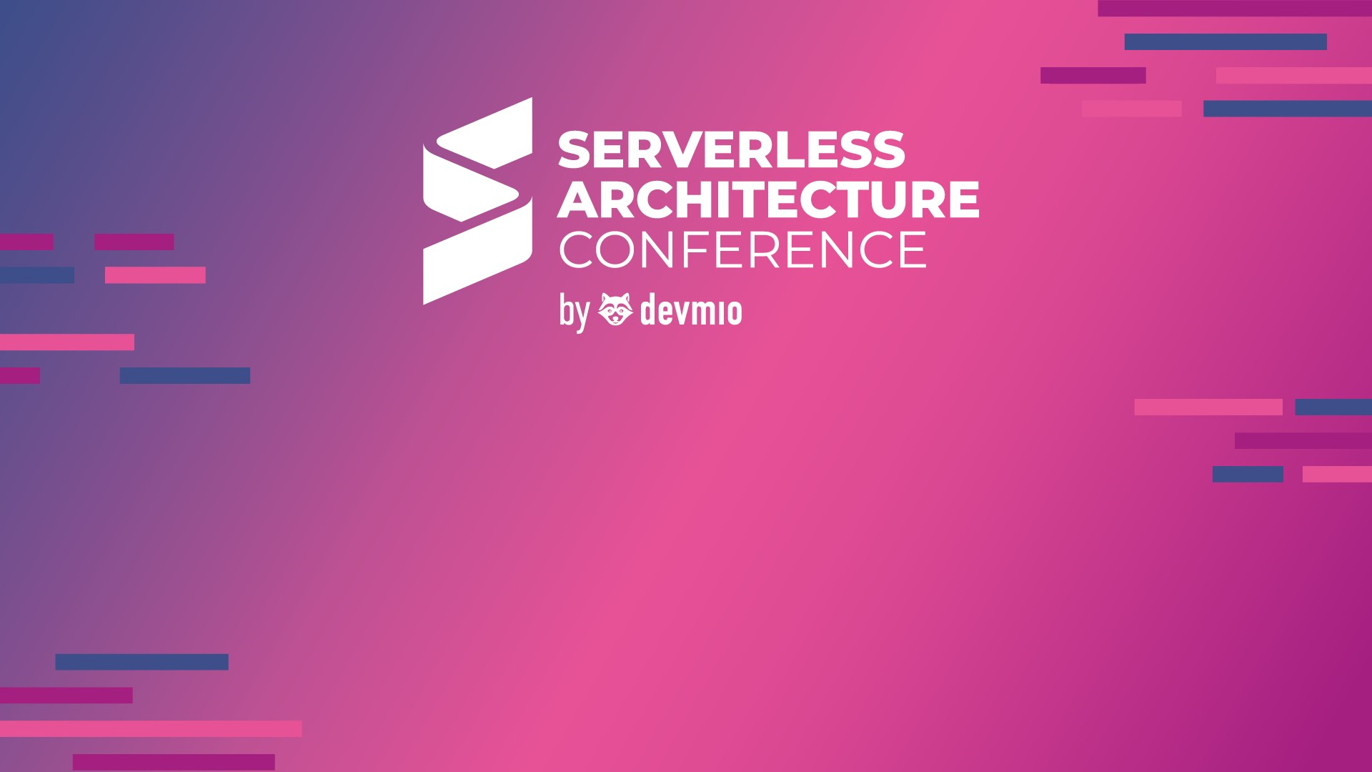
Implement a Serverless Data Platform with Microsoft Azure
Roberto Freato – Azure MVP / Author / CTO @Witailer

Slide 2
Agenda
What’s a Data Platform
Ingestion
Experimenting
Storage
Processing

Slide 3
Volume
Velocity
Variety
The quantity of ingested and analyzed data
The speed this data comes from the sources
The different types of datasets in terms of structure and semantic
The 3 V’s of Big Data
Notes:
Absolute vs Relative measurements
Gigs? TBs? Per day/month?
It is not a matter of complexity of the dataset itself, but the overall solution
Some sources can be trusted, some others not

Slide 4
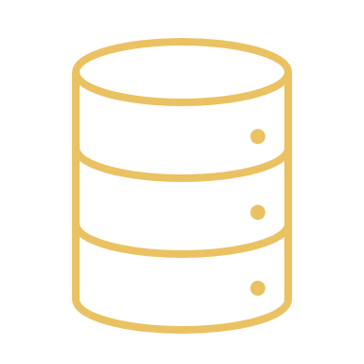
It’s not a matter of technology
Notes:
Misunderstanding about Data Warehouse
Even a relational Database can contribute to Big Data
Most of the Big Data Platforms rely on CSVs

Slide 5

Let’s try to define a Data Platform
In the problem space

Slide 6
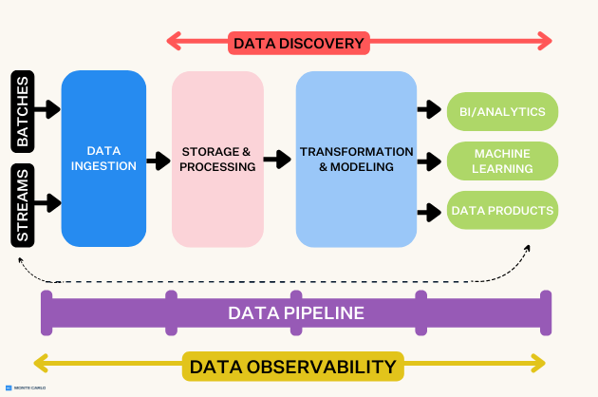
https://www.montecarlodata.com/blog-what-is-a-data-platform-and-how-to-build-one/
Notes:
A linear approach to the problem
We see two types of ingestion
The role of discovery and observability
We see a “light” feedback between data products and source

Slide 7
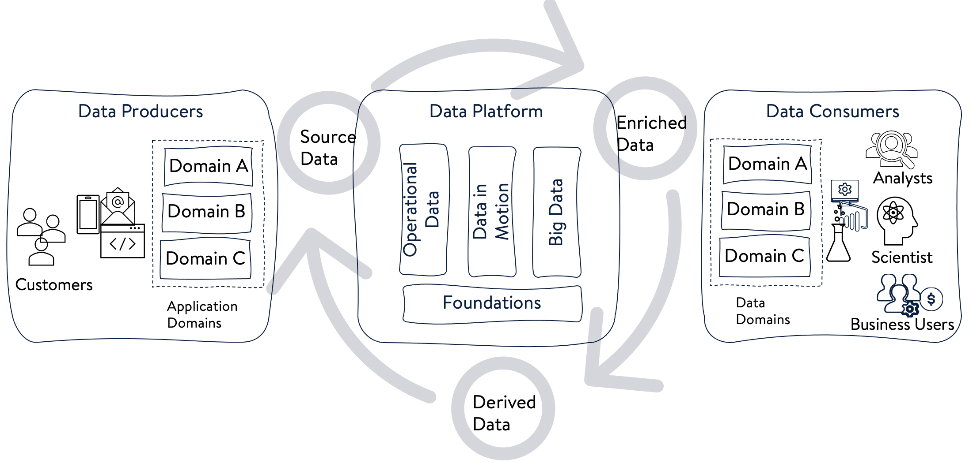
https://www.linkedin.com/pulse/modern-data-platform-how-build-one-anil-madan
Notes:
Few examples of incoming data sources:
Advertising
Ecommerce
IoT
The role of operational data
Consume dataset and why this is a circle

Slide 8
Bronze
Silver
Gold
Different formats
Much quantity
Consistency is not guaranteed
Data is filtered and cleaned
Quality increases
It is the single source of truth
Data is ready for consumption
Often is aggregated
Can represent a Data Product
Can be the source for other gold
Quantity
Quality
Medallion approach
Notes:
A path from quantity to quality
Reasoning about exposing different layers to stakeholders
Centrality of the Data Product

Slide 9
Let’s try to define a Data Platform
In the solution space

Slide 10
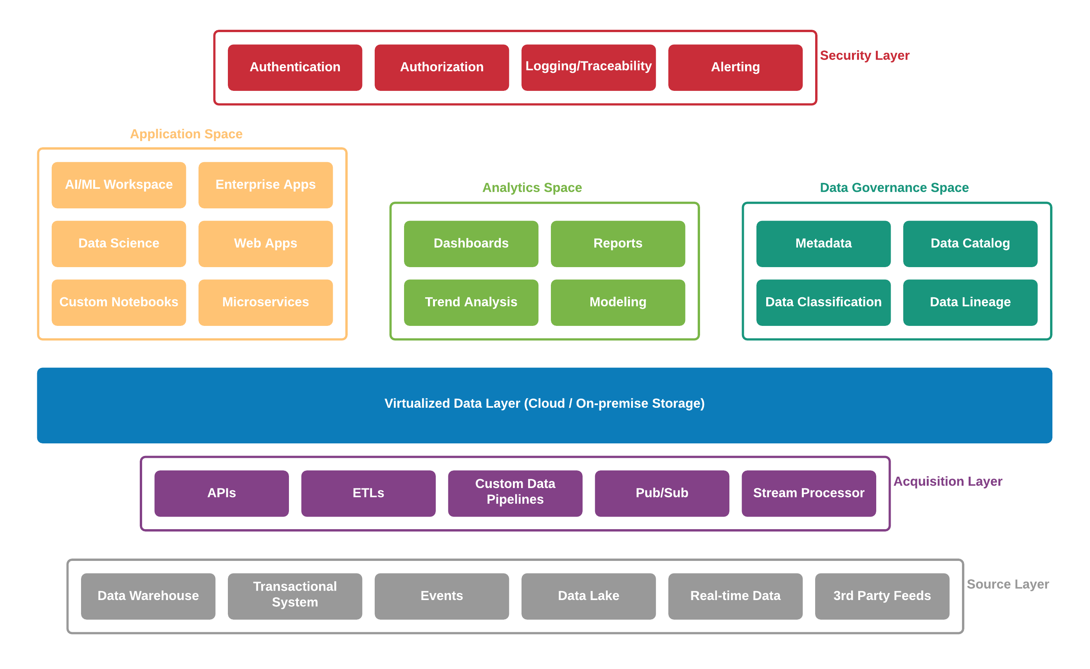
https://www.mongodb.com/what-is-a-data-platform

Slide 11
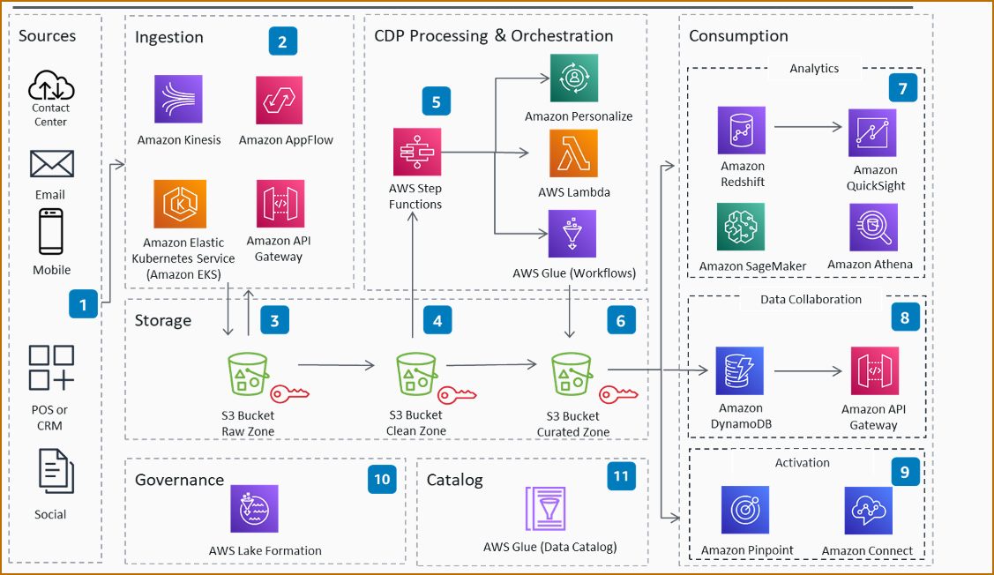
https://aws.amazon.com/blogs/architecture/a-modern-approach-to-implementing-the-serverless-customer-data-platform-cdp/

Slide 12
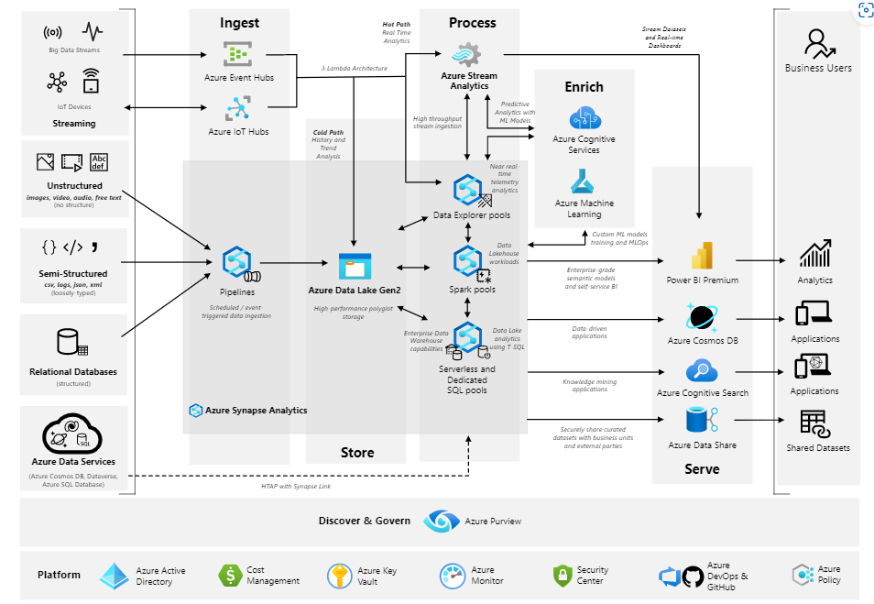
https://learn.microsoft.com/en-us/azure/architecture/example-scenario/dataplate2e/data-platform-end-to-end

Slide 13
Ingestion

Slide 14
Batching
Streaming
two conflicting neighbors

Slide 15
Streaming mode
highlights:
a single event can be lost
which doesn’t have too much payload (i.e. “notifications”)
the insights can be generated in real time
aggregation logics are mostly based on window functions
drawbacks:
hard to manage ordering and late arrivals
duplicates handling and immutability

Slide 16
Batching mode
highlights:
a data slice is collected on a schedule
we can collect and handle different batch sizes
common choice between “diff vs dump”
data is generally mutable
drawbacks:
hard to orchestrate
processes are not idempotent

Slide 17
Mixed mode
highlights:
we collect batches “as messages”
an event can be lost, a message no (i.e. an Order)
not necessarily interested in real-time insights
but full event-driven observability
we can ELT in the plain-old-way
we can manage the late arrivals (and duplicates)
drawbacks:
harder to implement

Slide 18
Streaming or Batching?
Both?

Slide 19
“Implement full streaming when you really need real-time insights”
– Me

Slide 20
Service Bus
Event Hub
Event Grid
Fully featured message broker
Peek-and-lock
Limited in scalability
Message-driven
Service Bus on steroids
Less features but more scalability
Kafka-compatible
Event-driven
Push-only logic (no state)
Great for notification events
Integrated with Azure-related events
Super-scalable
Streaming options

Slide 21

Storage

Slide 22
Data Lake
Database
storage options

Slide 23
Database mode
highlights:
It’s relational
great for relational integrity (foreign keys)
good for normalization
good for applications
drawbacks:
“not ideal” for analytical applications
limited in space and scalability
it is often “single-master”

Slide 24
Data Lake mode
highlights:
It’s file based
files can be everything
scalability is highest
it is ideal for analytical processing
(with proper data formats)
unlimited* in storage space
drawbacks:
no way to handle relationships
enforce rules is really painful

Slide 25
DEMO
Ingestion and Storage with Event Hubs, Stream Analytics and Data Lake

Slide 26

Experimenting
How to see the Data Lake as a Database

Slide 27
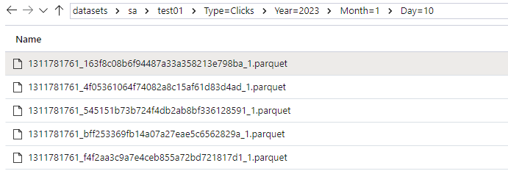
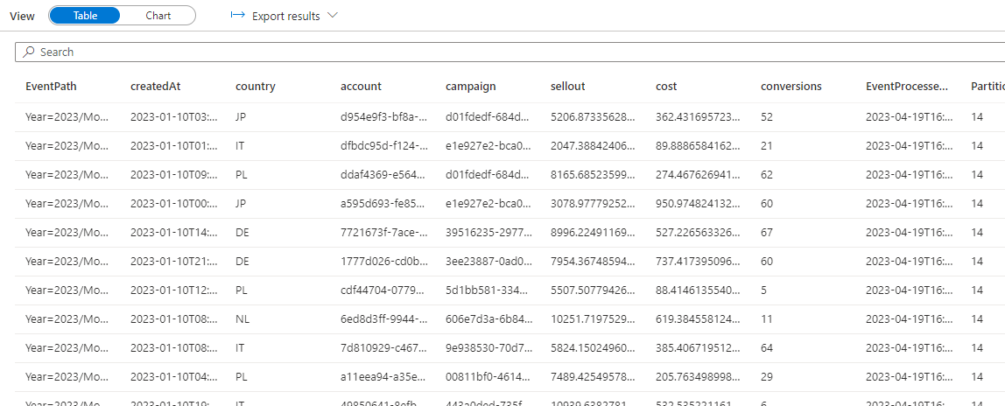

Slide 28
DEMO
Synapse Serverless Pool as RDBMS bridge

Slide 29

Processing

Slide 30
Low-code
Code
processing options

Slide 31
Pipelines
Data Flows
Spark
No code
Serverless
Drag and drop
Limited in data manipulation
Spark-based but no code
«almost» serverless
Advanced alternative
100% customizable
Code-based
Capacity-based
Synapse options
Notes:
Absolute vs Relative measurements
Gigs? TBs? Per day/month?
It is not a matter of complexity of the dataset itself, but the overall solution
Some sources can be trusted, some others not

Slide 32
DEMO
Gold making with Synapse Data Flows

Slide 33
We scratched just the surface…
Reacting to Azure Blob storage events | Microsoft Learn
Introduction to Azure Service Bus, an enterprise message broker - Azure Service Bus | Microsoft Learn
Design a PolyBase data loading strategy for dedicated SQL pool - Azure Synapse Analytics | Microsoft Learn
Apache Spark in Azure Synapse Analytics overview - Azure Synapse Analytics | Microsoft Learn
Serverless compute tier - Azure SQL Database | Microsoft Learn
What is Delta Lake? - Azure Synapse Analytics | Microsoft Learn

Slide 34
Takeaways
Make your choice between Streaming or Batching
Choose the right technology or a blend of many
Evaluate data formats like CSVs, JSONs, Parquets and Delta
Use the Serverless Pool to explore and size your Data Platform
Use Pipelines, Data Flows and/or Spark for the Data Engineering
Explore alternatives before making a huge Data Platform

Slide 35

Questions?

Slide 36
Thanks!
Roberto Freato – Azure MVP / Author / CTO @Witailer

Slide 37
Implement a Serverless Data Platform with Microsoft Azure
Roberto Freato – Azure MVP / Author / CTO @Witailer

